Slide 1

Sailing the docker ship
~ Sanyog Vyawahare

Slide 2
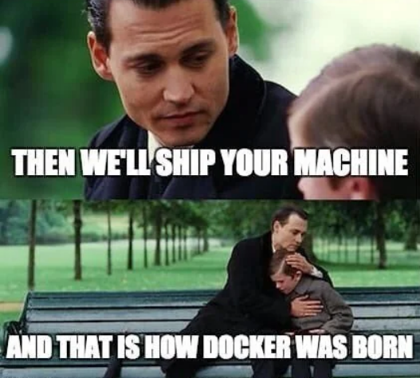

Docker was Born

Slide 3
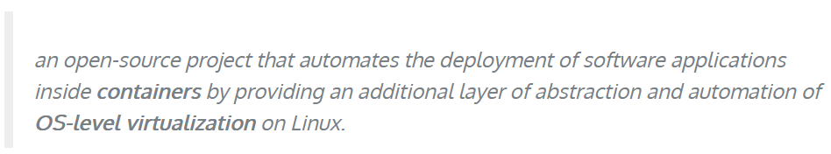
What is Docker?
Something
Takes my working code
Makes it work other machines

Slide 4
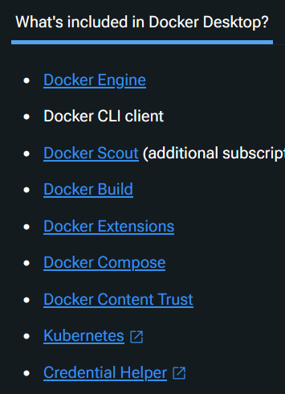

Docker Installation?
Install: Docker Desktop
Should be enough
Multiple Containers
(Advance)
https://docs.docker.com/desktop/

Slide 5
What will we discuss today
What is docker
How does it work?
Image, Build, and Containers
Run Docker
Pull, Run, Port, Detach, Logs
Tags
Slim & Alpine
Persistence
Volume & bind-mounts
Build your own image
Dockerfile
Layers
Docker Compose

Slide 6
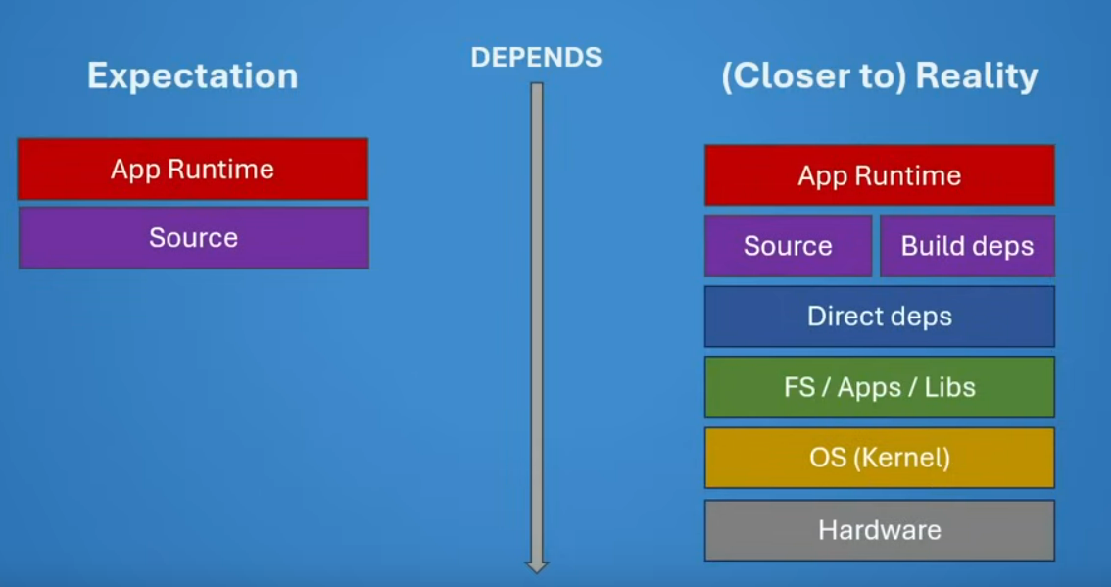

Slide 8
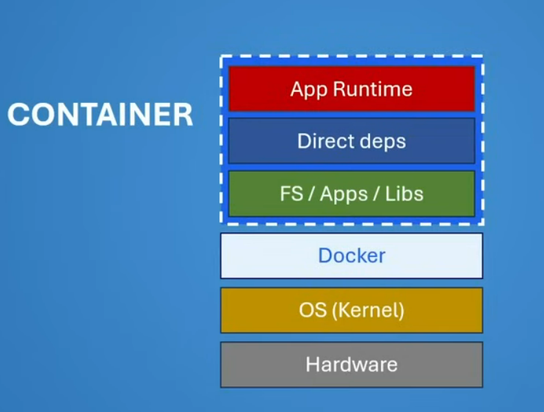
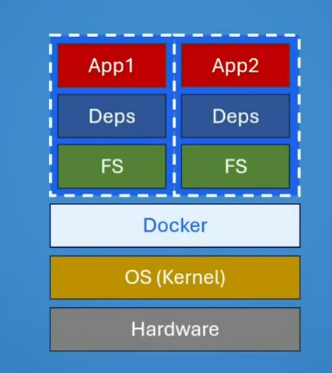
Independent Containers

Slide 9
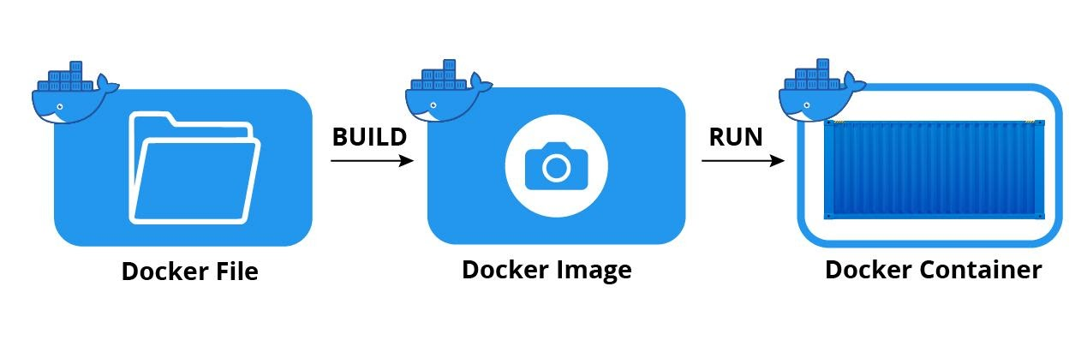
Components

Slide 10
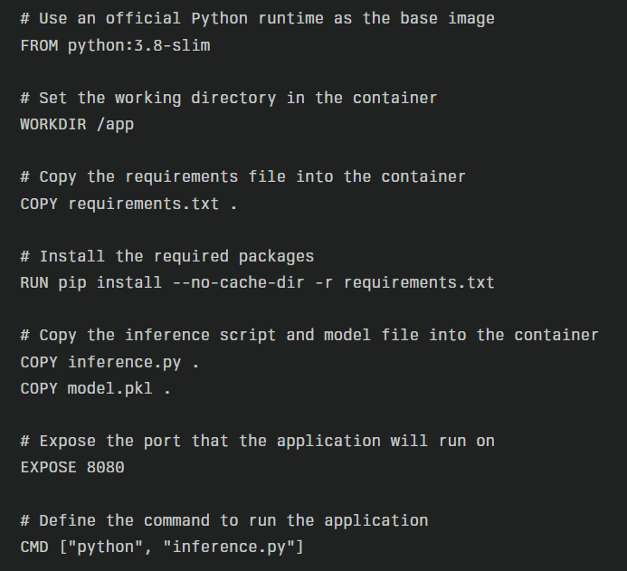
Docker File
Docker Base
Setup a working dir
Execute a command while building this image
Copy content to working directory inside docker
Port you will expose for inference
Run inference script when online

Slide 11
Mount VS COPY
Docker Container
My Local PC
Build
Copy
./Model.pkl
<work_dir>/Model.pkl
100 MB
100 MB
Update the weights
Docker Container
My Local PC
./Model.pkl
<work_dir>/Model.pkl
110 MB
100 MB

Slide 12
Mount VS COPY
Docker Container
My Local PC
Mount
model dir
./model/Model.pkl
<work_dir>/model/Model.pkl
100 MB
100 MB
Update the weights
Docker Container
My Local PC
./model/Model.pkl
110 MB
<work_dir>/model/Model.pkl
110 MB

Slide 13
Docker File
Docker Base
Setup a working dir
Execute a command while building this image
Copy content to working directory inside docker
Port you will expose for inference
Run inference script when online

Slide 14
Components

Slide 15
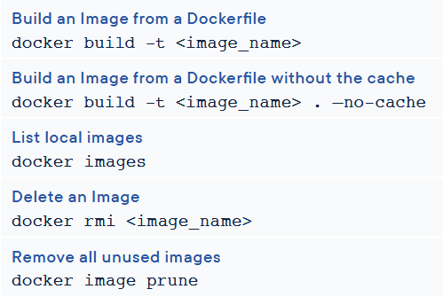
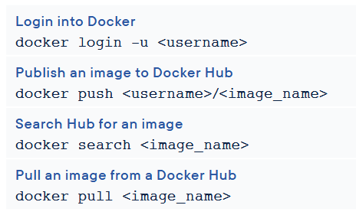
Docker Command Cheat-sheet

Slide 16
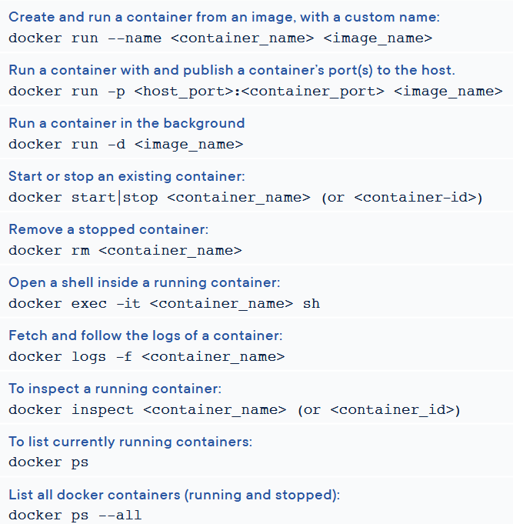
Docker Command Cheat-sheet

Slide 17
Inference using Docker
Deploying a text translation model

Slide 18

Compose

